Slide 1

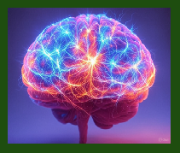
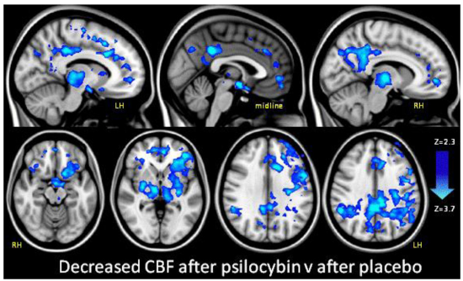
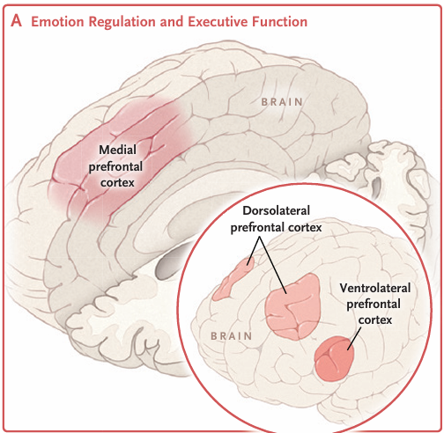
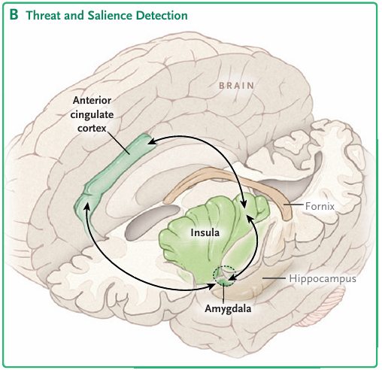
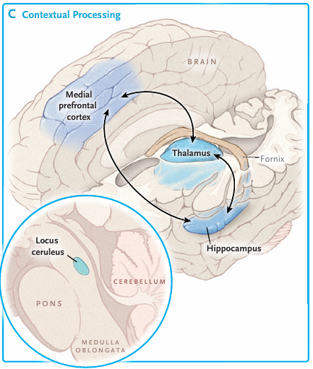
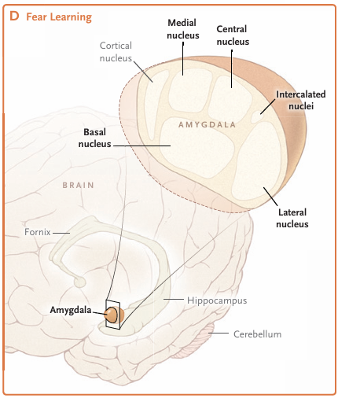
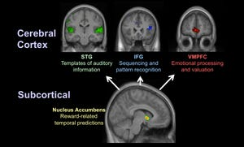
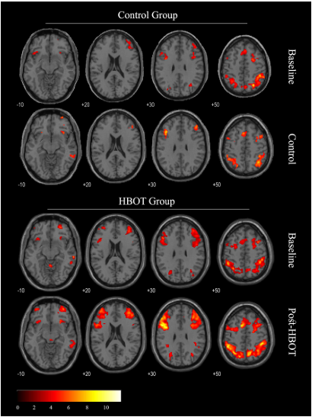









C
Creating a Theoretical Holistic, Natural Treatment for Post Traumatic Stress Disorder: A Literature Review
¹Erika Avila, ²Olivia Arnold
¹ Behavioral and Cognitive Neurosciences Undergraduate Program, Colorado State University, Fort Collins, CO
²Dept. Of Environmental and Radiological Health Sciences, Colorado State University, Fort Collins, CO
Post Traumatic Stress Disorder
Natural Treatments
Results
Post traumatic stress disorder (PTSD) is a psychological impairment of prolonged distress after a person experiences a traumatic event.
PTSD symptoms vary but may include:
Heightened fear response
Reoccurring intrusive thoughts about the traumatic event, triggers, or nightmares
Intensified stress and mood swings
Insomnia
Associated disorders such as substance abuse, depression, and anxiety
Psilocybin Therapy
Potent serotonin agonist
Increase’s neuroplasticity
Disrupts default neuronal circuitry
Decreases inflammation
Shown promising results in both micro and macro dosing.
Cognitive Therapy
Trauma focused cognitive behavioral therapy is the best observed psychological intervention for PTSD.
Exposure therapies tackles trauma head-on, with discussion of traumatic event.
Non-exposure explores feelings and cognitions post trauma.
Repeat engagement with the trauma helps to neutralize fear.
Many novel treatments could offer support to the current cognitive processing therapy gold standard used to treat PTSD.
Therapies which involve activation of the brain regions implicated in PTSD such as the amygdala, prefrontal cortex, and anterior cingulate gyrus show to have positive influence on PTSD.
Conclusion
A combination of these therapies would offer the best option for patients suffering from PTSD. Utilizing a nutrition plan, psilocybin therapy, bibliotherapy, music therapy, and HBOT all paired with cognitive processing therapy could alleviate PTSD symptoms sending them into remission with little chance of negative side effects. These therapies are also low cost which may enhance appeal among patients.
Brain Regions Involved
Music Therapy
Has shown positive impact both in listening and playing music.
Different areas of the brain activated during musical audition.
The amygdala is activated during active listening, this region is implicated in PTSD and has a strong influence on emotional processing.
Bibliotherapy
Reading offers an outlet to both focus the mind and find enjoyment, encouragement, or information through the content.
Some studies show this to be a positive and constructive way of processing emotions.
Can be viewed as a self actualization therapy.
Encourages healthy brain function
Future Directions
A study utilizing this treatment plan would offer clarity on effectiveness of this treatment compared to the current gold standard treatment plan.
More comprehensive exploration of each therapy individually would offer more insight to individual mechanisms and outcomes.
Acknowledgements & References
Dysfunction of executive function and emotional regulation
Increased threat detection
Inappropriate contextual processing, hypervigilance
Abnormalities in fear extinction
*Most likely cause for pathophysiology of PTSD
Works Cited
Alexandra Kredlow, M., et al. “Prefrontal Cortex, Amygdala, and Threat Processing: Implications for PTSD.” Neuropsychopharmacology, no. 1, Springer Science and Business Media LLC, Sept. 2021, pp. 247–59. Crossref, doi:10.1038/s41386-021-01155-7.
Bensimon, Moshe, et al. “Drumming through Trauma: Music Therapy with Post-Traumatic Soldiers.” The Arts in Psychotherapy, no. 1, Elsevier BV, Jan. 2008, pp. 34–48. Crossref, doi:10.1016/j.aip.2007.09.002.
Bird, Catherine I. V., et al. “Psilocybin and MDMA for the Treatment of Trauma-Related Psychopathology.” International Review of Psychiatry, no. 3, Informa UK Limited, Apr. 2021, pp. 229–49. Crossref, doi:10.1080/09540261.2021.1919062.
Choi, Charles, et al. “Mechanisms of Psilocybin on the Treatment of Posttraumatic Stress Disorder.” Journal of Psychopharmacology, SAGE Publications, Oct. 2024. Crossref, doi:10.1177/02698811241286771.
Fonseka, Lakshan N., and Benjamin KP Woo. “Therapeutic Role of Psilocybin and 3,4-Methylenedioxymethamphetamine in Trauma: A Literature Review.” World Journal of Psychiatry, no. 5, Baishideng Publishing Group Inc., May 2023, pp. 182–90. Crossref, doi:10.5498/wjp.v13.i5.182.
Jack, Sarah J., and Kevin R. Ronan. “Bibliotherapy.” School Psychology International, no. 2, SAGE Publications, May 2008, pp. 161–82. Crossref, doi:10.1177/0143034308090058.
Khan, Amanda J., et al. “Psilocybin for Trauma-Related Disorders.” Current Topics in Behavioral Neurosciences, Springer International Publishing, 2022, pp. 319–32, https://doi.org/10.1007/7854_2022_366.
Kline, Alexander C., et al. “Long-Term Efficacy of Psychotherapy for Posttraumatic Stress Disorder: A Meta-Analysis of Randomized Controlled Trials.” Clinical Psychology Review, Elsevier BV, Feb. 2018, pp. 30–40. Crossref, doi:10.1016/j.cpr.2017.10.009.
Krediet, Erwin, et al. “Reviewing the Potential of Psychedelics for the Treatment of PTSD.” International Journal of Neuropsychopharmacology, no. 6, Oxford University Press (OUP), Mar. 2020, pp. 385–400. Crossref, doi:10.1093/ijnp/pyaa018.
Lenkowsky, Ronald S. “Bibliotherapy: A Review and Analysis of the Literature.” The Journal of Special Education, no. 2, SAGE Publications, May 1987, pp. 123–32. Crossref, doi:10.1177/002246698702100211.
Ma, Yi-Ming, et al. “Efficacy and Acceptability of Music Therapy for Post-Traumatic Stress Disorder: A Systematic Review and Meta-Analysis of Randomized Controlled Trials.” European Journal of Psychotraumatology, no. 1, Informa UK Limited, Apr. 2024. Crossref, doi:10.1080/20008066.2024.2342739.
Markowitz, John C. “Is Exposure Therapy Necessary to Treat PTSD?” Interpersonal Psychotherapy for Posttraumatic Stress Disorder, Oxford University Press, 2016, pp. 1–26, https://doi.org/10.1093/med:psych/9780190465599.003.0001.
Mottershead, Richard, and Marjorie Ghisoni. “Horticultural Therapy, Nutrition and Post-Traumatic Stress Disorder in Post-Military Veterans: Developing Non-Pharmaceutical Interventions to Complement Existing Therapeutic Approaches.” F1000Research, F1000 Research Ltd, Sept. 2021, p. 885. Crossref, doi:10.12688/f1000research.70643.1.
Schnyder, Ulrich, et al. “Psychotherapies for PTSD: What Do They Have in Common?” European Journal of Psychotraumatology, no. 1, Informa UK Limited, Aug. 2015. Crossref, doi:10.3402/ejpt.v6.28186.
Shalev, Arieh, et al. “Post-Traumatic Stress Disorder.” New England Journal of Medicine, edited by Dan L. Longo, no. 25, Massachusetts Medical Society, June 2017, pp. 2459–69. Crossref, doi:10.1056/nejmra1612499.
Hyperbaric Oxygen Therapy (HBOT)
Seen to improve PTSD symptoms.
Increase activity in key brain regions.
Primary treatment of PTSD includes cognitive
therapy and pharmaceuticals
Current PTSD treatments have low response
rates and often do not bring on remission.
Lifetime PTSD impacts 1.3% to 12.2% of the
global population.
Nutrition
Good nutrition improves mood and physical health.
Low-glutamate diet aims to reduce excitotoxicity.
Low glutamate diet has been associated with a reduction of PTSD symptoms and lower cortisol blood levels.
Hypothesis
Novel treatments for PTSD show promising results. Natural therapies (treatment without pharmaceuticals) could be combined which may offer long lasting remission of symptoms without negative side effects.

