Slide 1

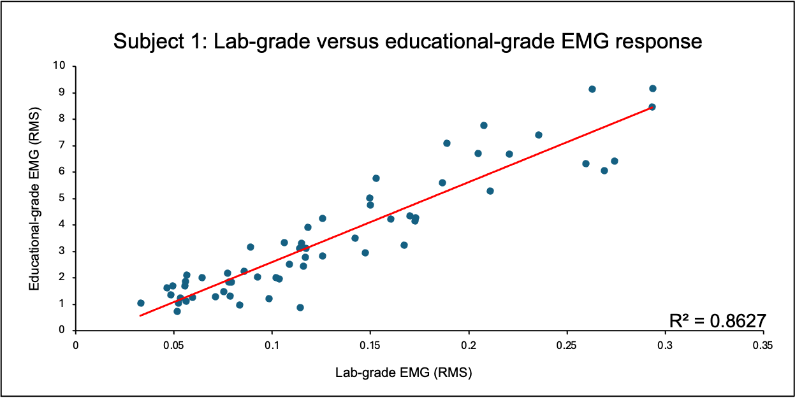
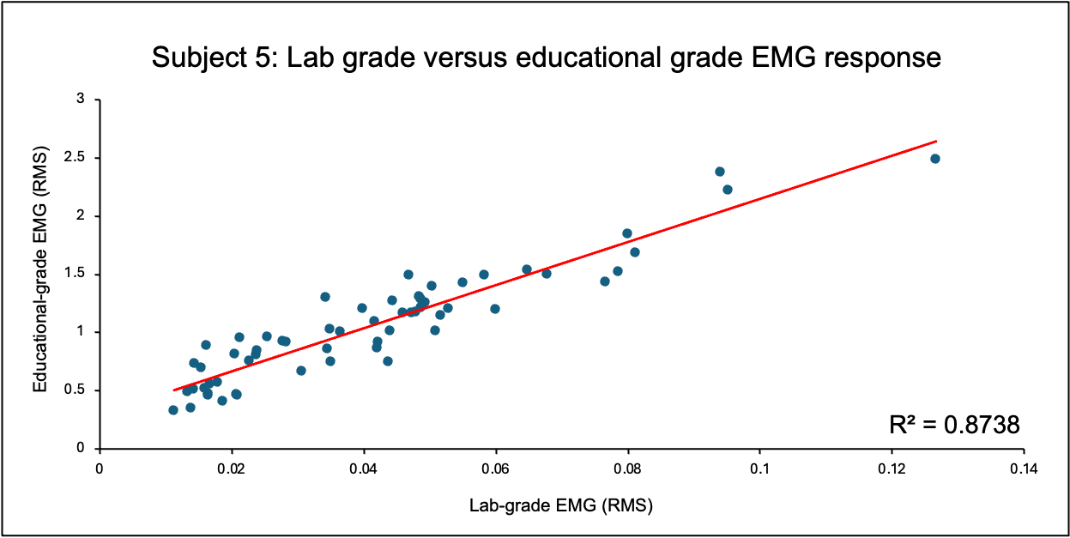
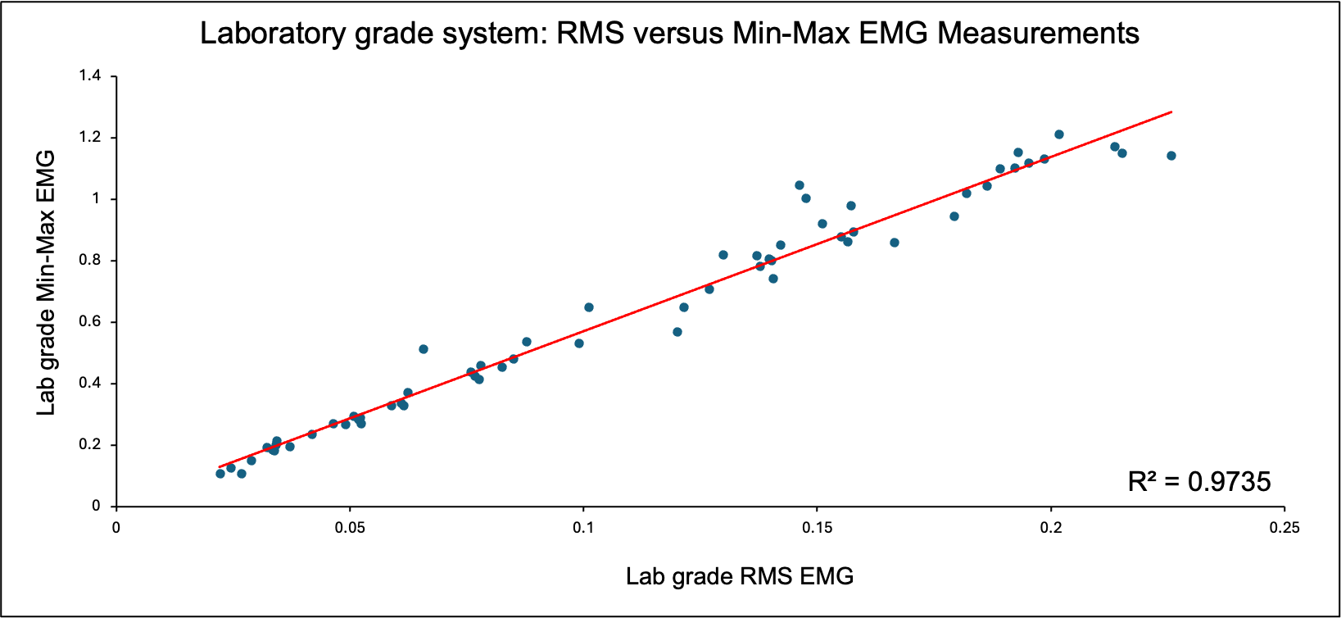
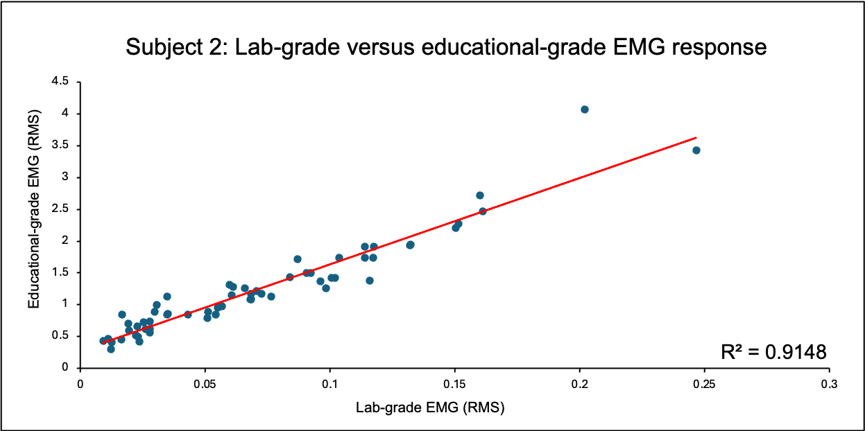
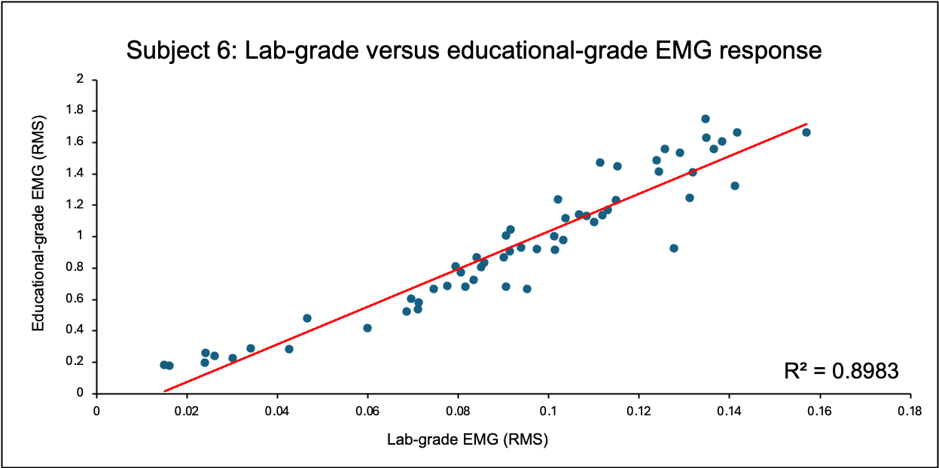
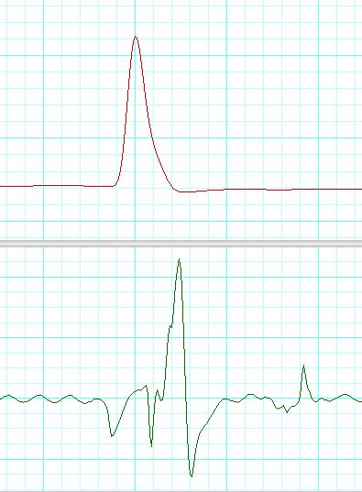
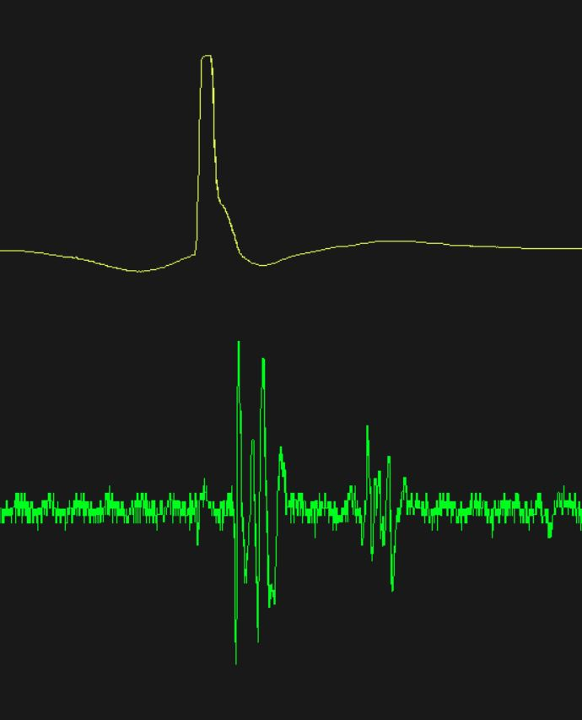
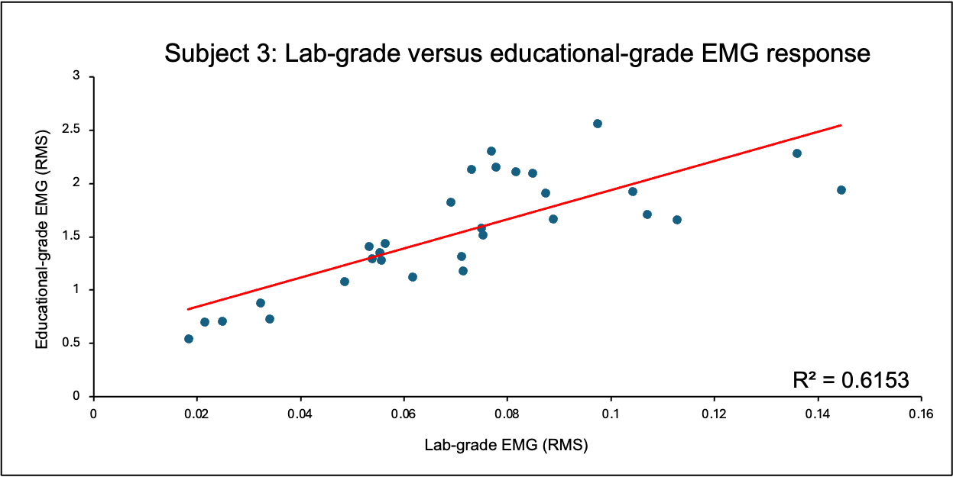
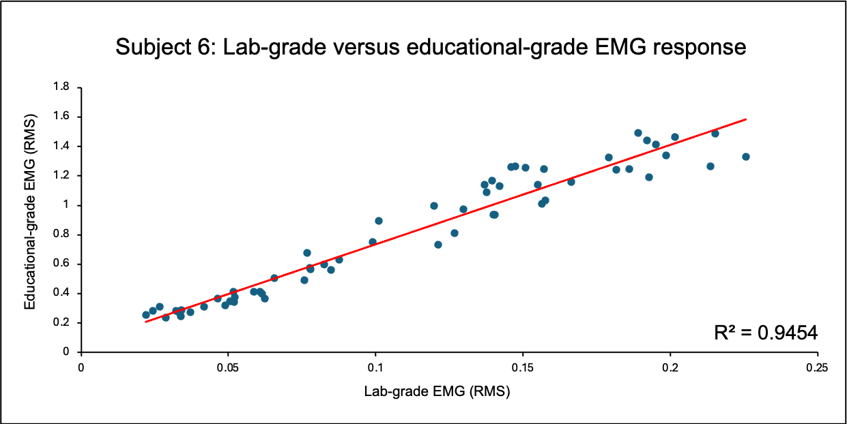
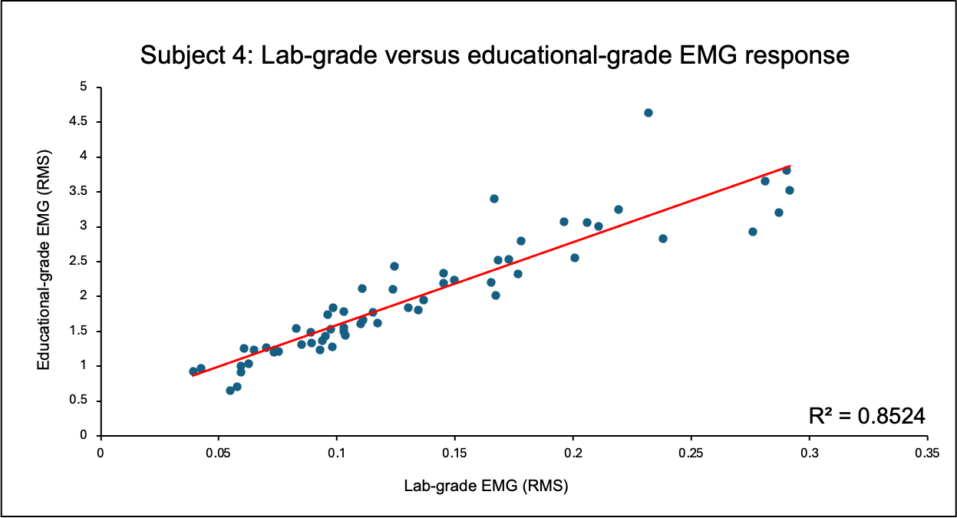
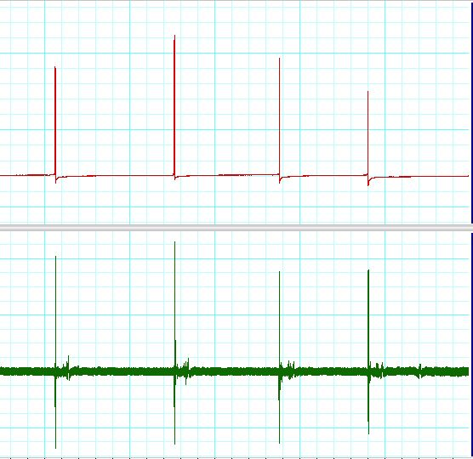
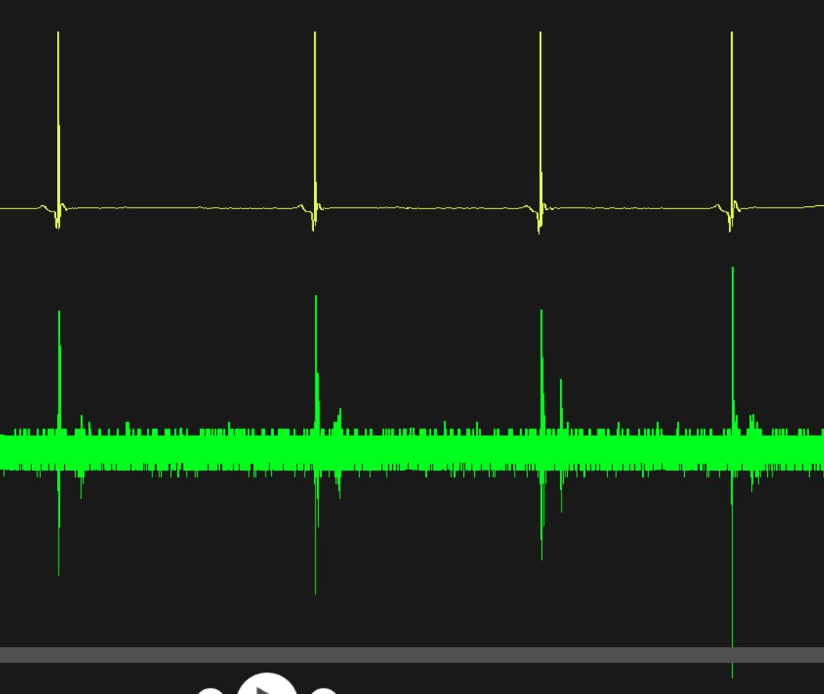
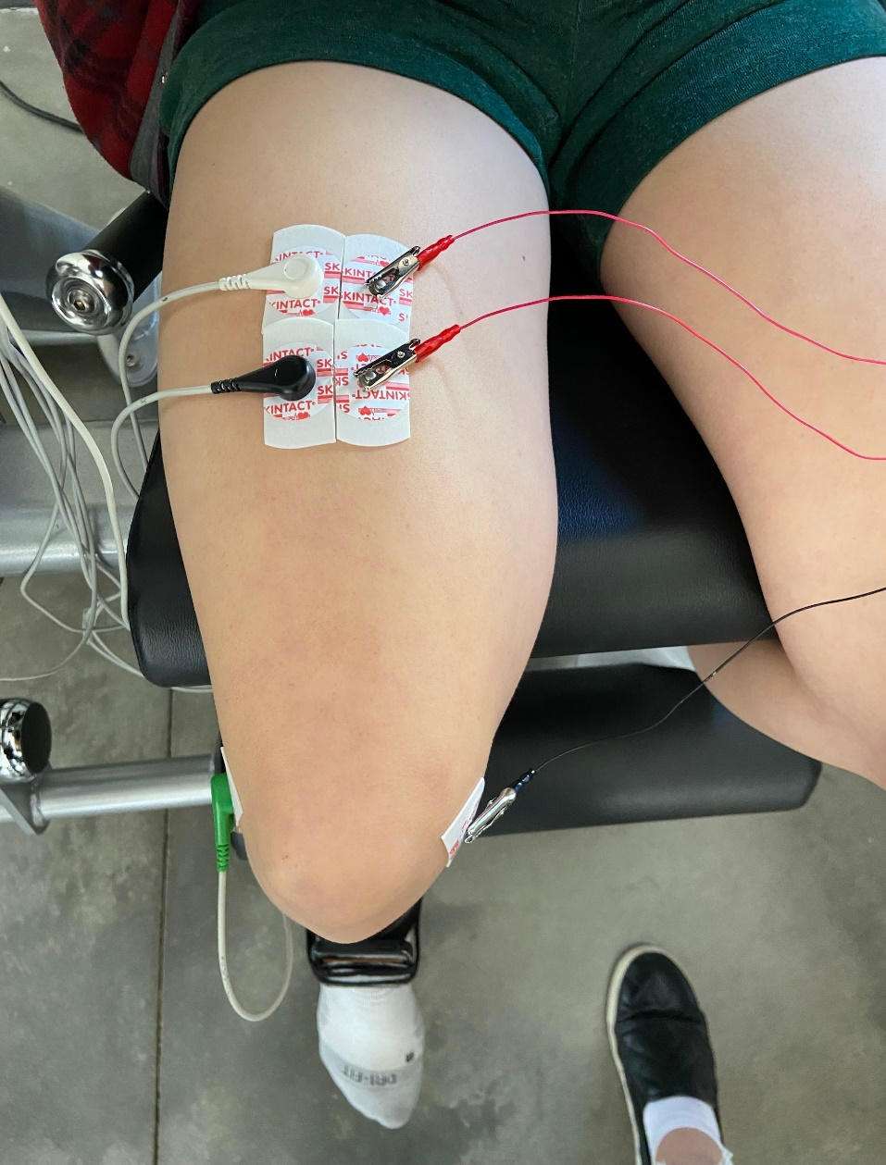
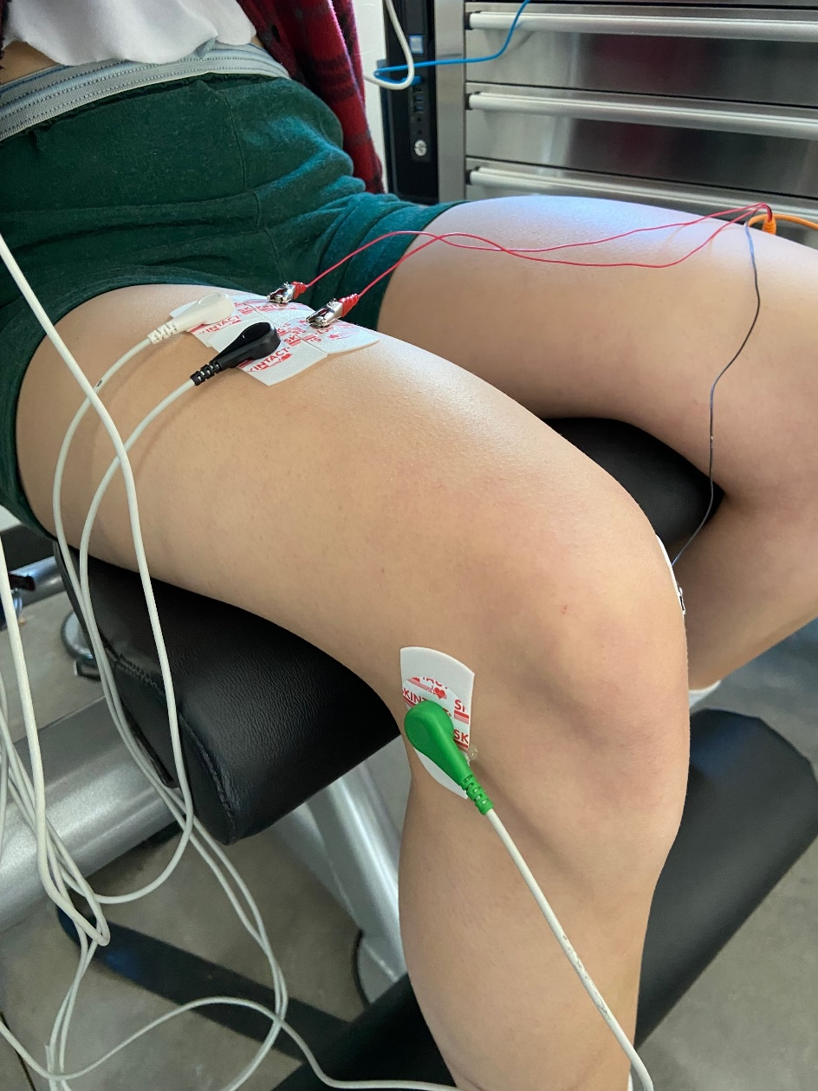
Experiential Student Lab Project: Measures of the stretch reflex electromyogram
Hannah N. Sims, Anna C. Coney, Catherine R.J. Curnutte, Brian L. Tracy
Department of Health and Exercise Science, Colorado State University, Fort Collins, CO
INTRODUCTION
RESULTS
Hands-on, experiential measurement of the commonly studied stretch reflex is valuable for learning in the neuromuscular physiology teaching laboratory.
Lab-grade electromyogram (EMG) systems are very expensive, limiting institutional access to multiple systems.
This can prevent accessibility to true hands-on, experiential small group work for undergraduate students.
The lab-grade ADInstruments EMG system costs > $12,000, whereas education-grade, portable EMG (Backyard Brains, Inc.) costs ~ $300.
The purpose of this undergraduate, in-class, group laboratory project was to compare the stretch reflex EMG data collected from an inexpensive, accessible system with a laboratory-grade system.
Figure 1
Figure 5
Figure 8
Figure 2
Figure 6
Scatterplot and regression of EMG RMS values vs EMG Max-Min values from the ADI system for 60 tendons taps from one subject. The two methods of quantifying the amplitude of the EMG response (RMS, Max-Min) were very strongly and tightly correlated (P< 0.01).
METHODS
Subjects
Seven female student participants (class lab group, 20-21 yrs). Participants enrolled in a neuromuscular physiology or supervised college teaching course.
Equipment
Backyard Brains (BYB) portable EMG kit (Human Spikerbox).
Lab-grade ADInstruments (ADI) EMG amplifier system.
Experimental Setup
Each participant was seated in a leg extension machine, and a mark was placed over the patellar tendon to provide a target for the tendon taps.
Software for each system collected two independent data streams: LabChart8 for the ADI system, and Spike Recorder for the BYB system.
Electrode pairs from both the ADI and BYB system were adjacently placed over the rectus femoris muscle to assure measurement from a similar volume of muscle.
Data Collection
A total of 60 tendon taps (10 soft, 10 medium, 10 hard) were performed for each subject under two conditions: 1) control, and 2) Jendrassik maneuver.
EMG responses from both the ADI and BYB systems were recorded
Figure 3
Figure 7
Figure 4
Figures 1-7. Scatterplots and linear regression of EMG RMS values from the ADI system vs. the BYB system for both conditions pooled (control and Jendrassik). EMG amplitude from both systems are measured in RMS (root mean squared). For the seven students, the R² values from the regressions between the two devices were 0.62, 0.85, 0.86, 0.87, 0.90, 0.91, 0.95 (all P< 0.05). All individuals demonstrated a strong positive correlation for the EMG values between the two systems.
ADInstruments patellar tendon tap data displayed on LabChart 8.
Backyard Brains patellar tendon tap data displayed on Spikerbox program.
CONCLUSIONS
For each student, the 60 pairs of values were strongly positively linearly correlated between devices (all P<0.05).
The two different types of EMG measures from the ADInstruments system (Max-Min vs. RMS) are tightly correlated. Therefore, the RMS value is an acceptable amplitude measure for discrete EMG bursts. This supports the strategy of comparing the ADI RMS values with the BYB system’s RMS values.
The portable, inexpensive Backyard Brains reflex response kit (EMG Spiker Box plus hammer) is an acceptable alternative to expensive lab-grade equipment for assessing stretch reflex electrophysiology in the teaching lab.
This could increase accessibility for instructors and students in university and secondary physiology education.
Electrode setup

