Slide 1
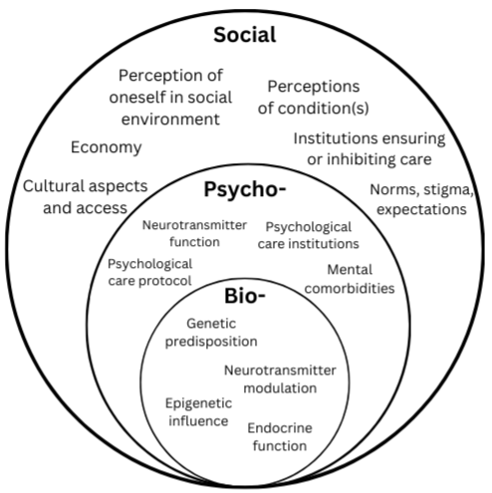
Investigating the Biopsychosocial Factors Impacting Eating Disorder/Disordered Eating Etiology, Advocacy, and Treatment Within the LGBTQIA+ Community
Audra Richister, College of Health and Human Sciences
Introduction
Etiology
Conclusions
Individuals within the LGBTQIA+ community have been found to experience eating disorders and disordered eating (ED/DE) at a rate disproportionately higher than cisgender, heterosexual populations. Research regarding either topic is relatively new, yet expanding efforts and knowledge related to such is urgent. Much pre-existing research material is biased towards cisgender, heterosexual populations, resulting in the exclusion of and further harm towards queer and trans patients. It also tends to undermine consideration of the full scope of ED/DEs, thus limiting knowledge about such and resulting evidence-based practice.
Epigenetic factors may influence ED/DE risk but exhibit untimely effects—may not apply to present issue.
Psychological institutions tend to be hegemonic and rigid, excluding queer and trans experiences across the span of ED/DE and violating their safety.
Social experiences of rejection, discrimination, assimilation may confound social etiology of ED/DE.
Many ED/DE experiences are congruent with minority stress theory.
Shame can be present in a variety of LGBTQIA+ experiences with ED/DE.
Cultural aspects are evident—example: queer and trans subcultures may be marked by unique relationships to food.
Advocacy | Treatment
Maintain outreach within recovery-based settings | Develop LGBTQIA+ specific therapy/treatment protocols
Reform diagnostic standards | Emphasize community-based recovery
Expand research | Implement critical treatment approaches
Objectives
This project was completed via review of existing literature pertaining to ED/DE and composition of an analytic research paper. Research was based off the biopsychosocial model of ED etiology, as well as catered to queer and trans demographics. Research sought to answer the following inquiries:
What are the current statistics relating to LGBTQIA+ individuals with ED/DE?
What might be impacting these statistics to be higher or lower?
How may one facilitate recovery for queer and trans individuals in the most holistic, inclusive ways possible?
Future Directions/Limitations
Advancing care needs to occur through integration of multiple principles including community, equity, and intersectionality.
Limitations: lack of research on certain populations, inhibition of research development
Acknowledgements
I would like to thank Dr. Brittney Sly for aiding in this research as my mentor. Thank you to my committee: Dr. Molly Cotner, Dr. Rochelle Richards, Alyson Welker, Ally Moseley. This research would not be what it is without you.
Figure 1. Graphical summary of the biopsychosocial model of ED etiology plus examples of risk factors per field.

