Slide 1
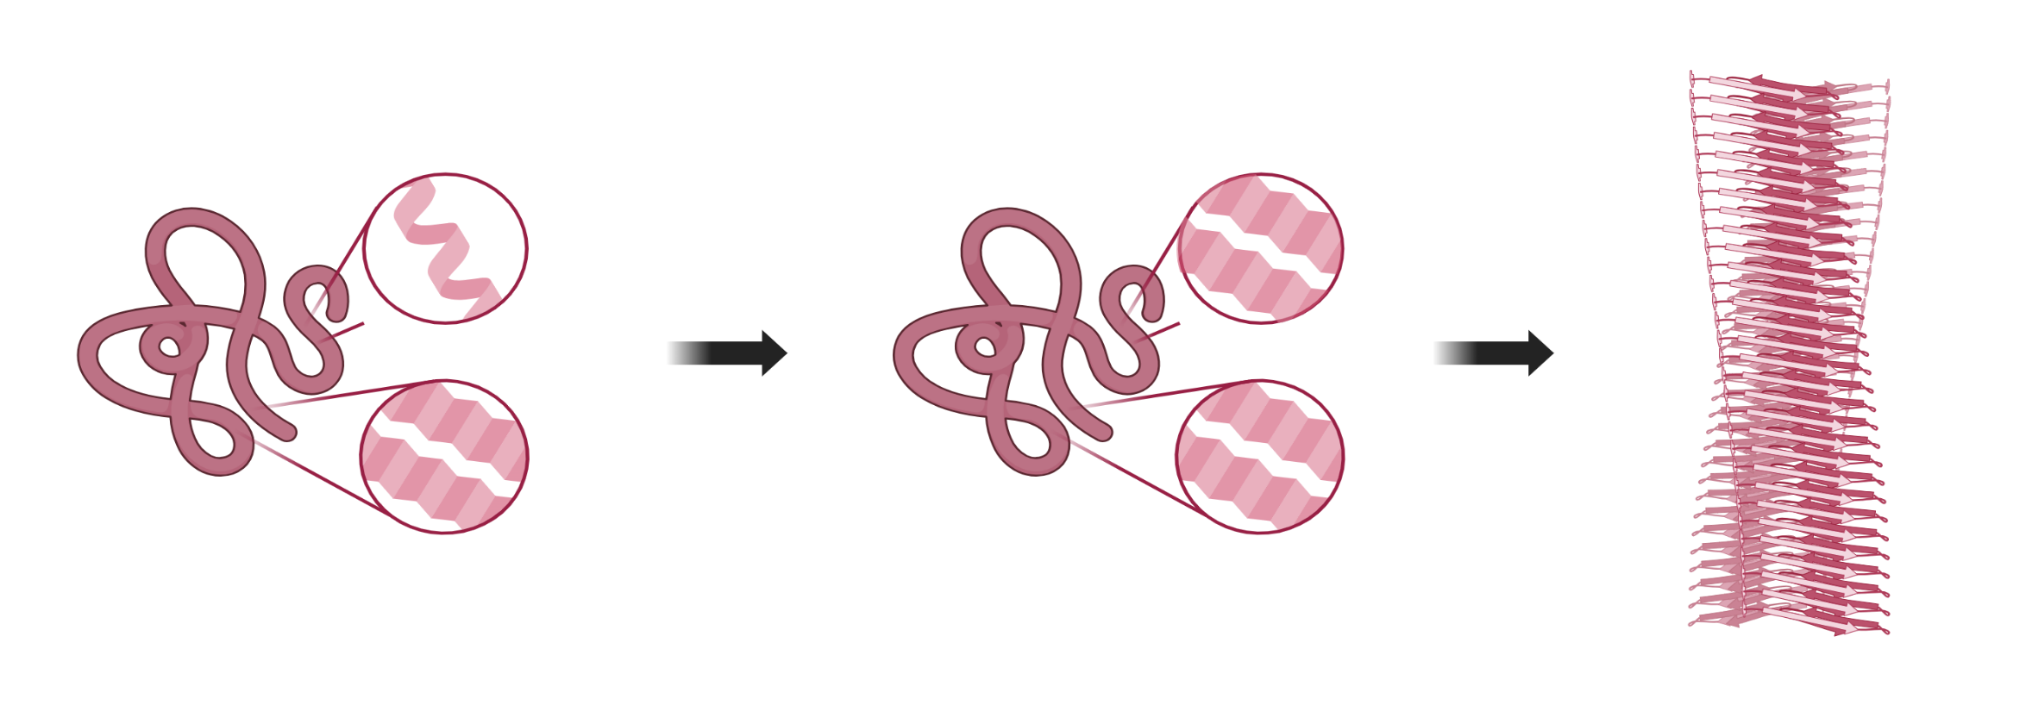
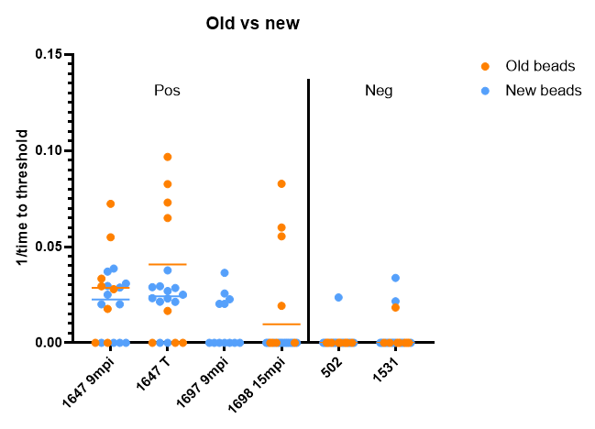
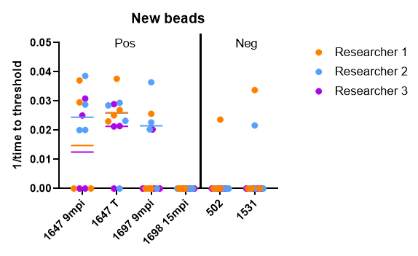
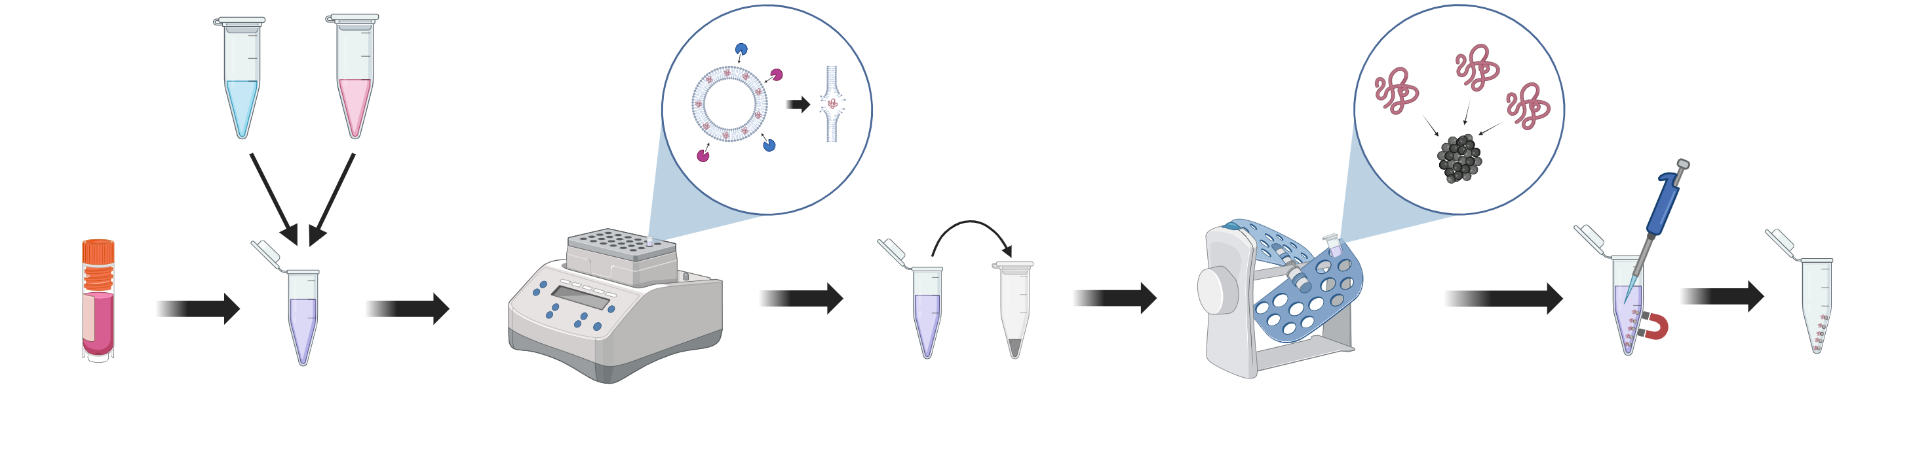
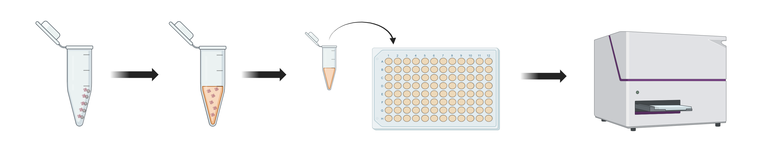
Determining the impact of vaccination on the temporal presence of prions in the blood of chronic wasting disease challenged white-tailed deer
George AJ¹, McNulty EE¹, Nalls AV¹, Denkers ND¹, Schaetzl H², Holger W², Mathiason CK¹
¹Colorado State University, Fort Collins, CO, USA ²University of Calgary, Calgary, Alberta, Canada ³University of Alberta, Edmonton, Alberta, Canada
Introduction
Results
Chronic Wasting Disease (CWD) is the fatal neurodegenerative disease of deer, elk and moose caused by the accumulation of misfolded prion protein (PrP^{C}).
In its misfolded state (PrP^{CWD}), a high concentration of beta sheets are present, which form amyloid fibrils.
Figure 1. RT-QuIC analysis of various buffy coat samples. Two different lots of iron oxide beads were run to ensure that results would be repeatable and not dependent on the specific beads used. This assay shows significant rates of amyloid formation in four of the samples taken from different deer at different timepoints post-inoculation. Lower rates of amyloid formation are shown in both negative controls
Native PrP^{C}
Misfolded PrP^{CWD}
Although infectious prions have been demonstrated in the blood of infected sheep, cattle, deer, and humans, in vitro detection of blood-borne prions has been hampered by low concentration and assay inhibitors.
Here we use our established modified prion amplification assay “lipase, iron-oxide bead, QuIC (LIQ), to detect hematogenous CWD prions in our longitudinal study.
Our lab has been studying two different vaccine candidates for CWD. In the first year of the study, white-tailed deer (WTD) were immunized without CWD challenge to ensure the safety and efficacy of the vaccine. Deer cohorts receiving either or both vaccines in combination remain healthy demonstrating vaccine safety.
Additional years of deer cohorts, after receiving a vaccine prime/boost series, were orally challenged with CWD and are being monitored for CWD status and shedding profiles including the presence of prions in their blood
Figure 2. RT-QuIC analysis of buffy coat samples at different time points post- inoculation on multiple deer. Three researchers prepared the same samples to ensure that results would be repeatable. This assay shows significant rates of amyloid formation in three of four positive samples, indicating that PrP^{CWD} can be detected at any point after nine months post-inoculation. Lower rates of amyloid formation are shown in each of the negative controls.
Methods
The LIQ method first breaks down the phospholipid bilayer of the extracted buffy coat cells using lipases. As the samples are heated and incubated, the prions located in the bilayer are released.
Add lipases to buffy coat sample prepared in PBS
Incubate in thermomixer for 1 hour at 37˚ C
Add buffy coat solution to iron oxide beads
Place samples in end-over-end rocker for 1 hour
Separate iron oxide beads from solution with magnet and remove supernatant
The misfolded prions are extracted in higher quantities using iron oxide beads (IOB), which strongly attract the prions when added to the samples.
RT-QuIC can then be run on the IOB samples to determine the rate of amyloid formation. The samples are combined with recombinant PrP (rPRP), which acts as a template for amyloid formation, and Thioflavin T (ThT), which produces detectable fluorescence when interacting with amyloid fibrils.
The increased concentration of extracted prions allows smaller amounts of PrP^{CWD} in the samples to be detected.
Conclusions
Future Directions
Comparison between the two different lots of beads shows that both sets of IOB act similarly, but more plates need to be run.
The experimental design produces similar results when recreated by multiple different researchers.
Presence of PrP^{CWD} can be detected at 9 months post inoculation using the LIQ assay
Use the LIQ assay to determine the efficacy of two vaccine candidates to mitigate CWD infection and shedding, and fill knowledge gaps about the role of the immune response in CWD infection and mitigation
Resuspend isolated beads in 0.1% SDS
Transfer to QuIC plate containing ThT, rPrP, and QuIC buffer
Acknowledgements
Run RT-QuIC for 65 hours at 55˚ C
Images created in https://BioRender.com

